Slide 1
If statement with more than 1 condition
If (<condition1>) AND/OR (<condition2>)
then <True choice is executed>
else <False choice is executed>
The then-section is executed when the result of the logic operator(s) is True
The else-section is executed when the result of logic operator(s) is False

Slide 2
If continued
Brackets must be used with the And or Or operators in compound conditions
The number of ‘(‘ and ‘)’ brackets and begin / end combinations must be the same
Statement comments //Then -1 to 100 help to keep track of the number of begin / end combinations (most of the time every begin has a corresponding end)
Plan your solution – make sure that you know which condition(s) to use in every If-statement before coding the program. Also decide on the components you are going to use

Slide 3
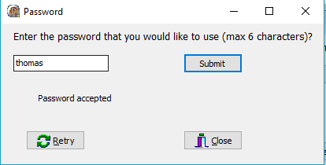
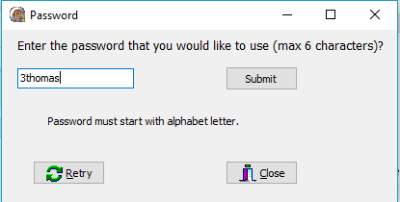
Activity 3.2
Write a program that asks the user to choose any password (a string) that is between one and six characters long. The only restriction other than the length is that the string must start with an alphabetical character (upper or lower case). The program must read the string and check whether its first letter is valid. It must then display an appropriate message which tells the user whether the password is valid or not.

Slide 4
Simplifying decision making with sets
A set is a collection of values of the same ordinal type. It can contain either no values or one or more values. The values contained in the set are indicated in square brackets.
Examples of sets:
[1..6] meaning 1, 2, 3, 4, 5 and 6
['a', 'e', 'i', 'o', 'u']

Slide 5
Simplifying decision making with sets
The IN operator tests if the data is contained in the set or not:
If cLetter IN ['A'..'Z', 'a'..'z']
then Showmessage ('Character is a letter of the alphabet');

Slide 6
Activity 3.3
Open Act3_2, resave the activity as Act3_3
(click on Save AS – Act3_3_u, then click on SAVE Project – Act3_3_p).
Rewrite the If Statement by making use of a set with an IN.

Slide 7
Nested IF-then-else-end IF
The THEN part and the ELSE part, if any, can contain one or more IF-THEN-ELSE-END IF statement in one of the three forms. That is, when you feel it is necessary, you can use as many IF-THEN-ELSE-END IF statements in the THEN part and the ELSE part as you want. However, please note that any such IF-THEN-ELSE-END IF must be fully contained in the THEN part or the ELSE part. If you follow the box trick, this requirement is automatically satisfied. The following is an example:
IF (logical-expression) THEN
statements
IF (logical-expression) THEN
statements
ELSE
statements
END IF
statements
ELSE
statements
IF (logical-expression) THEN
statements
END IF
statements
END IF
IF <Condition1>
then <Statement1>
else If (<Condition2>) AND/OR (<Condition3>)
then If <Condition4>
then <Statement2>
else If <Condition5>

Slide 8
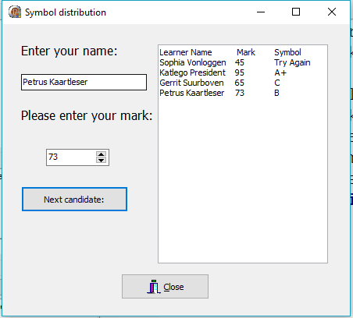
Example
When the mark is entered, the program must award a symbol: For 90 and higher a A+, else a A. Lower than 80 and higher than 59 receives a first class with the appropriate symbol, namely B for 70, C for 60. Lower than 60 symbols are awarded according to the mark.

Slide 9
Activity 3.4
TechSales software distributors have come up with a scheme to motivate their sales representatives. You must write a program which calculates the commission that a sales representative earns on his/her monthly sales. The commission is calculated according to the following rates:
Monthly sales (S) | Commission
S > R8 000 | 40%
R4 000 < S <= R8 000 | 20%
S <= R4 000 | 10%

Slide 10
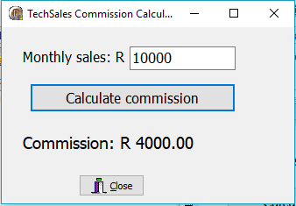
Activity 3.4 (cont)

Slide 11
CASE statement
CASE <selector expression> OF
<case 1> : <statement(s)>;
<case 1> : <statement(s)>;
<case 1> : <statement(s)>;
…………
[else <statement(s)>]
End;

Slide 12
CASE statement (cont)
The Case keyword provides a structured equivalent to a sequence of if statements on the same variable.
The Case statement is more elegant, more efficient, and easier to maintain than multiple if nesting's. Version 2. Is used for Records declarations. It is then called a Variant. It provides a means of mapping two or more differing sets of declarations onto the same section of the record. It is mostly used when handling different types of dataset for a record, where the datasets have mostly the same content. See the example for clarification. The Tag provides identification of the case element.

Slide 13
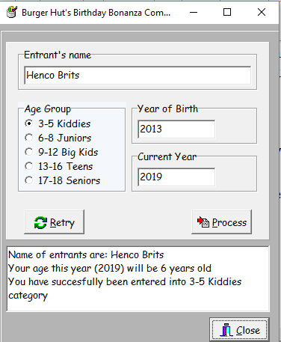
CASE statement (example)
if (iBirthYear > iYear) Then bValid := False;
sCategory := rgpAge.Items[rgpAge.ItemIndex];
if (iAge < 3) or (iAge > 18)
then
bValid := False;
Case rgpAge.ItemIndex of
0 : if iAge < 3
then bValid := False;
1 : if iAge > 8
then bValid := False;
2 : if iAge > 12
then bValid := False;
3 : if iAge > 16
then bValid := False;
4 : if iAge > 18
then bValid := False;
end; // Case

Slide 14
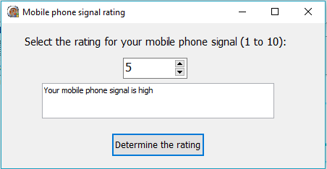
Activity 3.5
Rewrite the following nested IF statement in the form of a CASE statement:
IF ichoice IN [1..3]
then redMessage.lines.add (Your mobile phone signal is low)
else if iChoice IN [4..6]
then redMessage.lines.add (Your mobile phone signal is high)
else if (iChoice = 0) OR (iChoice IN [7..10])
then redMessage.lines.add (Your mobile phone signal is out of range)
else redMessage.lines.add (LOADSHEDDING);

